Slide 1
Driverless Cars Could Make Transportation
Free for Everyone –with a Catch
By Judith Donath

Slide 2
Warm-up questions:
What do you know about self-driving vehicles?
What impact do you see it may have on our life?
How do you understand the title “Driverless Cars Could Make Transportation Free for Everyone ---with a Catch?”

Slide 3
Scan the text and answer the following questions:
1. What are the hidden problems with driverless vehicles according to the author?
Answer:
Driverless vehicles provide free transportation to passengers, which in turn may result in unchecked consumption, more damage to the environment and even more health problem.
2.For the driverless vehicle system who would be the “driver”?
Answer:
The company that controls the algorithm.

Slide 4
Structural Analysis & Content Discussion
Para. 1
It presents predictions from journalists, futurists, economists and ethicists, serving as a backdrop to the author’s prognostications.

Slide 5
Para. 2--5
The author’s predictions: transportation will become free.
Unchecked consumption , customers being manipulated by businesses, potential pitfall and inherent conflicts …

Slide 6
Para. 6—20
Analyze how the system of driverless transportation works for the benefits of businesses through comparing it to the existing promoted rides, like UberFree. The author points out that the only difference, if there is any, is that the new hi-tech system is better at persuading people to buy.

Slide 7
Learning paraphrasing skill
Learning the skill of paraphrasing (expressing the meaning of the literary text by using different words) is very important skill as it is instrumental for you to show your understanding of the original text. Furthermore, learning to paraphrase is a preparatory and fundamental for summary writing.
Now try to paraphrase some sentences from the text.

Slide 8
Tasks
1. As self-driving cars inch closer to everyday reality, journalists, futurists, economists, and ethicists have weighed in with numerous predictions about autonomous vehicles’ future impact. (para.1)
The sentence can be understood as: As auto-driving cars are coming into reality, journalists, futurists, economists and ethicists have considered the possible impact the autonomous vehicles may have on our life in future.

Slide 9
2. Summon a car and travel for nothing—that is, so long as you are willing to stop en route at sponsoring locations.
The sentence could be understood as:
Get a driverless car and travel for free---that means so long as you are willing to stop at the sponsoring shops you don’t have to pay for your travel.

Slide 10
3.On top of that, some clubs present customers who arrive in a cab with high cover charges to make up for the driver’s kickback.
It can be understood as:
The most complaints are some clubs have customers who arrive in cab pay high service fees in order to compensate the driver’s kickback.

Slide 11
4. Payments (whether kickbacks or sponsorships) from a business to a driver (whether human or algorithmic) in return for redirecting people are a way for businesses to align the drivers’ incentives with their own. (Para.14)
It could be understood as:
Business pay drivers (whether in the form of kickbacks or sponsorships), in return the drivers will take more customers to the sponsorship shops. In this way the interests of both business and drivers are allied.

Slide 12
Getting the main idea of a paragraph
Getting the main point of a paragraph is one of the most challenging tasks in reading activity. Yet, compared with writing the main idea, recognizing it is less challenging .
Now work in group and match the summary sentence with its corresponding paragraph based on your comprehension.

Slide 13
1.___para._3______Routes and relevant stops are tailored based on riders’ personal data.
2. ___para.1_____With the emergence of autonomous autos, people have made predictions about the impact these vehicles will make on people’s life.
3. ___para._4_____More examples of riders tailored transportation services.
4._____para.2_____ According to the author, riders won’t need to pay in a world full of self-driving cars if the riders are willing to stop at shops on the route.

Slide 14
5.____para._5____ The rides with relevant stops at sponsored locations will appeal to both passengers and marketers.
6. ____para.13_____Cities may have more control once these algorithms are routing autonomous cars.
7. ____para.6_____People concern such free transportation with relevant stops at shops lead people to consume unrationally, which in turn will cause problems to individuals even to the society.

Slide 15
8. ____para.7_____There are potential pitfalls of this transportation arrangement that are obvious in the present promoted ride.
9. ____para.17_____With the intense technical development, the system supporting autonomous cars will work in a more human-like way.
10. ___para.10_____Under this system, divers get benefit at the passenger’s expense.

Slide 16
11. ___para._18____Autonomous cars will be part of an ecosystem of intelligent agents and personal-data vendors.
12. ____para.16_____There are a few reasons why we do not have widespread sponsored rides today.

Slide 17
Drill
Read and Summarize

Slide 18
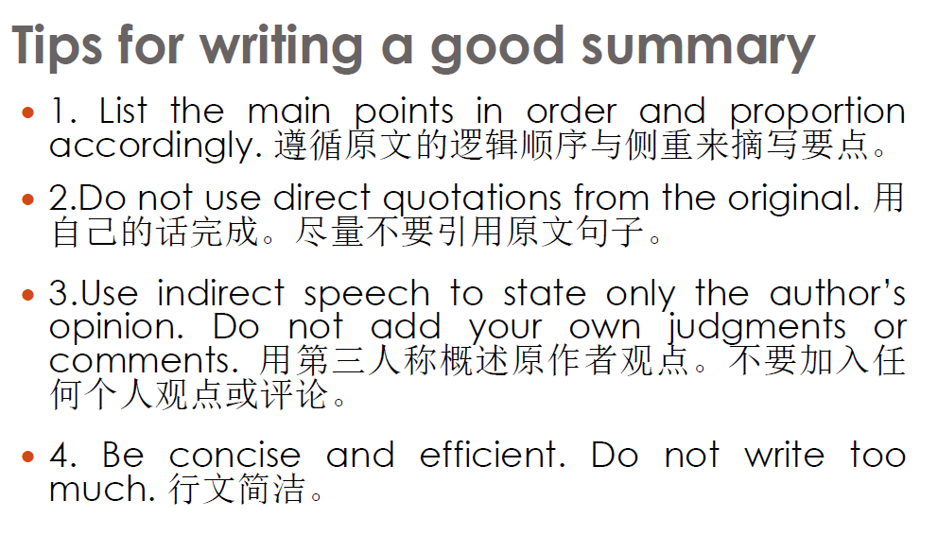

Slide 19
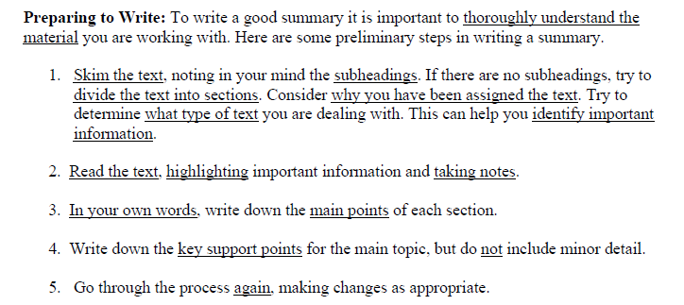

Slide 20
Key features of a summary
It is shorter than the source.
It repeats the ideas of the source in different phrases and sentences.

Slide 21
Tips & Tricks: Guidelines for Summarizing
Try creating two columns on a piece of paper: one for important information, and one for trivial information.
Organize your thoughts on this page, and try to only include important information in your summary.
The best summaries are usually only a paragraph long, clear and to the point.

Slide 22
Summary Format
A summary essay should be organized so that others can understand the source or evaluate your comprehension of it.
The introduction (usually one paragraph)
  Contains a one-sentence thesis statement that sums up the main point of the source.
  Also introduces the text (title, author, etc.)
  The article written by whom is concerned with what.
The body (one or more paragraphs)
  Includes important points.
  Includes one or more key examples or illustrations.
  Do not include your own ideas.
There is customarily no conclusion.
  Do not add your own concluding paragraph.

Slide 23
Checklist
Is it clear what is being summarized?
Is the thesis of the original essay clear in the summary?
If you have read the original source, did you identify the same thesis?
Is any key point missing?
Is there any of the summarizer’s own opinions?
Is there any unimportant details?
Is there any point in the summary where you are lost because a transition is missing?

Slide 24
Let’s read the text, take notes and evaluate summaries. (Exercise V.)
Notes:
可以布置给学生分组课上或课下完成，每组负责不同的部分。
三部分：第1-3段，第4-7段，第8-10段。

Slide 25
Summary Intro
The article written by whom is concerned with what.
In “…”, who (the author) does what.

Slide 26
Sample Summary of this article
In “Driverless Cars …”, Judith Donath explains the effect of driverless cars. He states that driverless cars will make transportation free, but they will also bring many problems. First, they will harm the benefits of the consumers (passengers), making them pay more money. Second, they would bring environmental problems. Furthermore, they endanger consumers’ information security. Finally, they would cause unchecked consumption. To sum up, the goal of driverless cars is no different from the Las Vegas Cabbie. They aim to make profit for themselves.

Slide 27
Assignment
Summary of “Can a “Triple Package”…
The article written by whom is concerned with what.
In “…”, who (the author) does what.
In “”, D.G. explains/discusses/introduces…
Amy Chua’s triple package thesis/hypothesis
How it is refuted by science/ two scholars…

Slide 28
Structure of this article
I. Introduction: the idea, public responses,
(Para.1-4) research purpose
II. Materials
and Methods: the test (sample, method,
(Para.5-7) procedures)
III. Results: the findings
(Para.8-9)
IV. Discussion: explanation, conclusion
(Para.10）

Slide 29
Exercise V: Translation the following into Chinese.
There are different opinions on who should be held liable in case of a crash, in particular with people being hurt. Many experts see the car manufacturers themselves responsible for those crashes that occur due to a technical malfunction or misconstruction. Besides the fact that the car manufacturer would be the source of the problem in a situation where a car crashes due to a technical issue, there is another important reason why car manufacturers could be held responsible: it would encourage them to innovate and heavily invest into fixing those issues,

Slide 30
not only due to protection of the brand image, but also due to financial and criminal consequences. However, there are also voices that argue those using or owning the vehicle should be held responsible since they know the risks involved in using such a vehicle. Experts suggest introducing a tax or insurances that would protect owners and users of autonomous vehicles of claims made by victims of an accident.

Slide 31
Answer key for your reference
由谁来承担车祸责任，特别是事故中有人受伤，对这个问题人们有不同的观点。很多专家认为汽车生产商应该承担由于技术故障或汽车结构缺陷引发的事故责任。除了由于技术故障引起的事故中生产者是事故的根源这一事实外，另一个让厂家负责的重要原因是它会促使生产者进行技术改进，投重资以解决技术问题，这么做不仅仅是为了保护品牌形象，也是因为承担经济和犯罪后果的需要。但也有另外的声音，他们认为既然车辆的使用者或拥有者知道其风险，他们也应该承担责任。专家们建议引入新的税种或险种，以保护这种自动驾驶车辆的车主和用户免受事故受害者的索赔。

